Slide 1

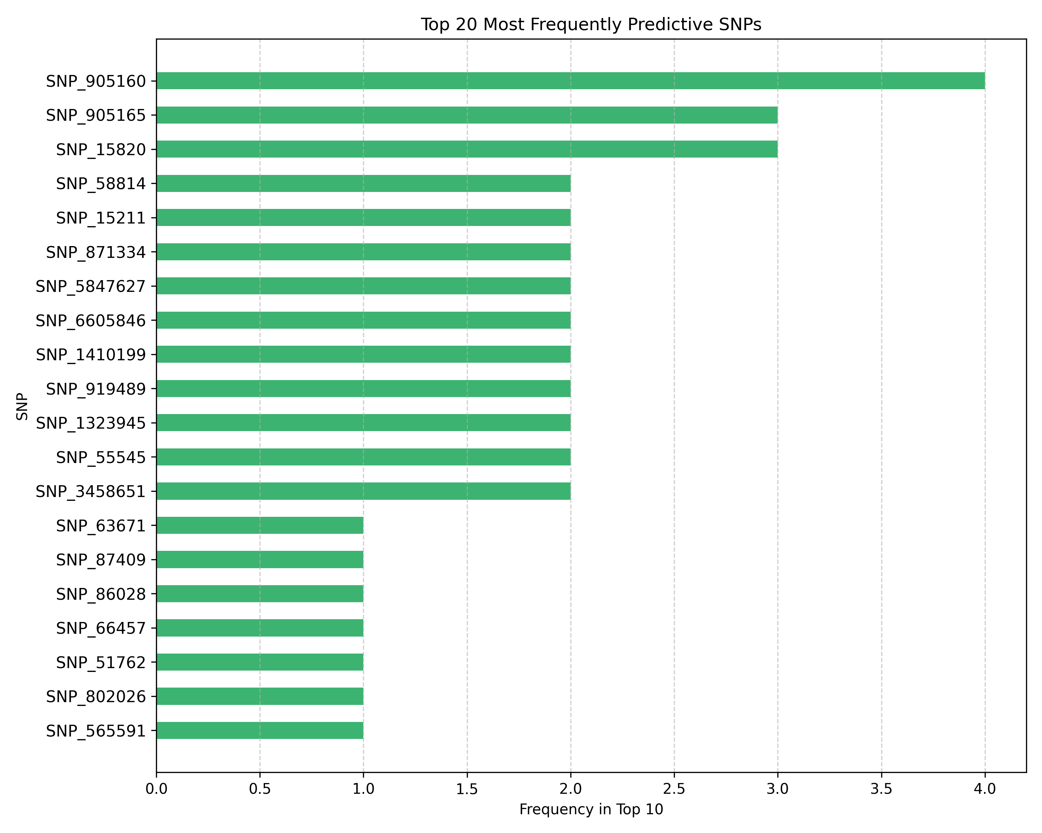
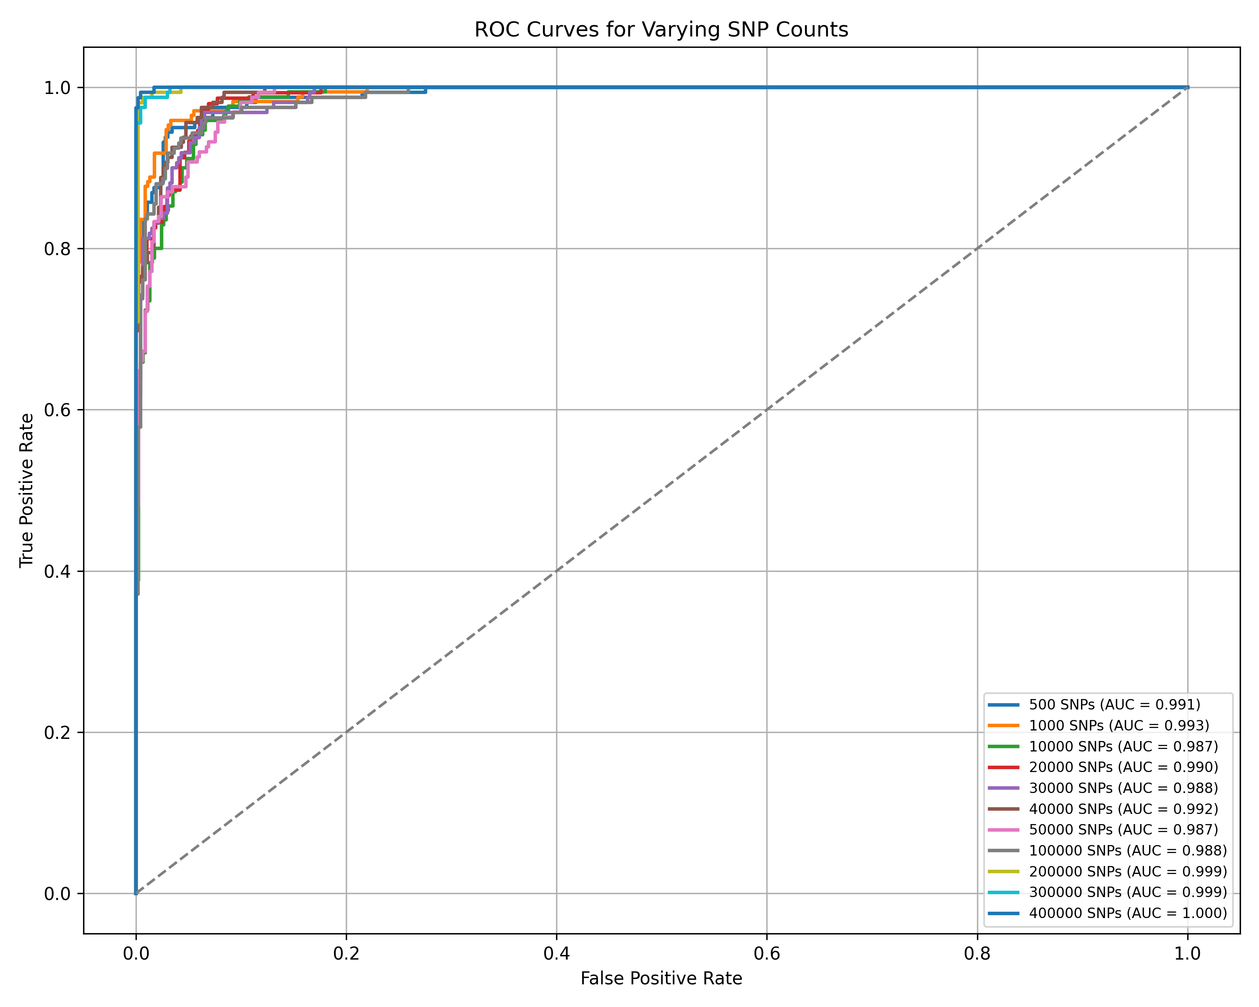
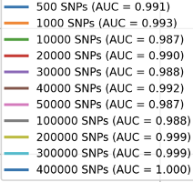
Polygenic Risk Score Prediction Using Machine Learning
Tanzania Vernon | https://github.com/Tanzaniav0825/Capstone-Project-Polygenc-Scores/tree/main
PACE UNIVERSITY
Abstract
Methodology
Results
Limitations
This project explores the use of machine learning to simulate and classify polygenic risk scores (PRS) using real genomic data from the 1000 Genomes Project. Unique biallelic SNPs were extracted from multiple chromosomes, and synthetic effect sizes (β values) were assigned using a normal distribution.
PRS for each individual were calculated as the weighted sum of SNP dosages and β values. Individuals in the top 25% were labeled high risk; the remaining 75%, low risk. A logistic regression model was trained to predict high-risk individuals based on their genotype data.
Results showed that even with simulated traits, the model effectively distinguished risk groups, validating this framework for controlled polygenic modeling. The approach provides a foundation for testing PRS pipelines before applying real trait-based GWAS data.
Data Source: Real SNP genotype data from Chromosome 1 of the 1000 Genomes Project
SNP Processing: Extracted biallelic SNPs and converted genotypes to dosage format (0, 1, or 2)
Simulated Trait: Assigned each SNP a β value drawn from a standard normal distribution to simulate polygenic effects.
PRS Calculation: I computed polygenic risk scores (PRS) as the weighted sum of SNP dosages and β values.
Labeling: Individuals in the top 25% PRS were labeled high risk(1); others as low risk(0)
Model Training: Trained a logistic regression classifier using the genotype matrix to predict high-risk individuals
Using only Chromosome 1 SNPs from the 1000 Genomes Project, a logistic regression model was trained to classify individuals by simulated polygenic risk.
The PRS distribution followed a normal curve, with the top 25% clearly separated as “high-risk.”
The model achieved strong performance with a high ROC AUC, demonstrating effective separation of high- and low-risk groups.
The top 20 SNPs most predictive of risk were identified based on model coefficients, improving interpretability.
This confirmed that even a single chromosome contains sufficient polygenic signal to train a reliable classifier in a simulated setting.
Simulated Labels: The project used randomly generated effect sizes rather than real GWAS data, limiting biological validity.
Single Chromosome Scope: Results are based only on Chromosome 1, so they may not generalize to full-genome polygenic risk.
Computational Constraints: Processing SNP data locally was resource-intensive. Attempts to include more than 400,000 SNPs caused the code to run extremely slowly or stall entirely.
Scalability: Runtime and memory usage increased significantly with larger SNP matrices, limiting experimentation with full-genome data.
No Causal Inference: The model captures statistical associations only – identified SNPs may not be biologically causal.
Population Bias: A uniform high-risk threshold was applied across individuals from diverse ancestries, potentially limiting generalizability.
Interpretability Limits: Though logistic regression is interpretable, simulated inputs reduce biological meaning of SNP weights.
Motivation
This project was inspired by a personal interest in the power of genetics to shape health outcomes. As a mother, I’m especially motivated by the hope that early, accurate genetic risk prediction can lead to better prevention and care for future generations – including my daughter who had several genetic anomalies when she was born. By exploring polygenic risk modeling, I aim to contribute to research that empowers individuals and clinicians with proactive, personalized insights.
Research Question
Future Work
How can machine learning be used to simulate and predict genetic disease risk using real genomic data?
Most common diseases are influenced by many small-effect genetic variants, making them difficult to predict. Polygenic risk scores(PRS) aim to aggregate these effects, but building and testing them often requires real trait data. This project explores whether simulated effect sizes, combined with real SNP data, can be used to train interpretable models for identifying high-risk individuals.
This project lays the foundation for scalable, simulation-driven PRS modeling. Future directions include:
Genome-wide Expansion: Extending the pipeline beyond Chromosome 1 to include all 22 autosomes for more comprehensive trait modeling.
Real Phenotype Integration: Using GWAS-derived effect sizes and clinically validated disease labels to replace synthetic traits.
Population-Specific Modeling: Adapting PRS thresholds and effect sizes to ancestry-aware frameworks.
Cloud or HPC Processing: Migrating to cloud or cluster computing environments to efficiently handle large-scale genomic datasets and model training.
Open-Source Contribution: Final code and methodology will be maintained on GitHub to support reproducibility, collaboration, and further development.
Related Works
Polygenic risk scoring has emerged as a powerful approach for predicting complex diseases influenced by many small-effect variants. Foundational works [1,2] outlined the clinical promise of PRS and emphasized the need for scalable frameworks that combine genotype data with predictive modeling. The tutorial by Choi et al. [3] formalized methodologies for simulating PRS, validating the use of normally distributed effect sizes as a first step toward building interpretable trait models.
Statistical limitations of PRS were quantified in [4], showing that effect size distributions and sample ancestry play critical roles in predictive accuracy. In psychiatric genomics, Wray et al. [5] demonstrated how PRS can stratify risk early in disease development, echoing the motivation for logistic regression as a transparent modeling choice. Duncan et al. [6] emphasized the dangers of ancestry bias, a limitation directly relevant to projects using diverse 1000 Genomes data with uniform labeling thresholds.
To address the signal decay in PRS from linkage disequilibrium LD), Vihjalmsson et al. [7] proposed LD-aware modeling, reinforcing the need for future extensions beyond SNP independence. Lello et al. [8] applied machine learning models, such as LASSO and support vector machines, to genome-wide PRS construction, supporting a broader methodological space for PRS training beyond linear models.
Data Set
Bibliography
Lambert, Samuel A., et al. Towards clinical utility of polygenic risk scores. Human Molecular Genetics 28.R2 (2019): R133-R142.
Torkamani, Ali Nathan E. Wineinger, and Eric J. Topol. The personal and clinical utility of polygenic risk scores. Nature Reviews Gentics 19.9 (2018): 581-590.
Choi, S. W., et al. Tutorial: polygenic risk score methods for complex traits. Nature Protocols 15.9 (2020): 2759-2772
Dudbridge, Frank. Power and predictive accuracy of polygenic risk scores. Plos Genetics 9.3 (2013): e1003348
Wray, Naomi R., et al. From basic science to clinical application of polygenic risk scores in psychiatry. JAMA Psychiatry 78.1 (2021): 101-109.
Duncan, Laramie E., et al. Analysis of polygenic risk score usage and performance across diverse human populations. Nature Communications 10.1 (2019): 3328
Vilhjalmsson, Bjarni J., et al. Modeling linkage disequilibrium increases accuracy of polygenic risk scores. Nature Genetics 47.8 (2015): 726-730
Lello, Louis, et al. Accurate genomic prediction of human height. G3: Genes, Genomes, Genetics 8.12 (2018): 3865-3872.
The 1000 Genome Project Consortium. The 1000 Genomes Project: a global refernence for human genetic variation.
I used genotype data from the 1000 Genomes Project, which includes whole-genome sequencing for over 2,500 individuals across 26 diverse populations. For this study, biallelic SNPs were extracted from Chromosome 1 using high-quality VCF files.
Genotypes were converted to dosage format (0, 1, 2) to enable numerical modeling. This real genomic structure provides a realistic foundation for simulating polygenic traits while controlling trait complexity.

